Slide 1
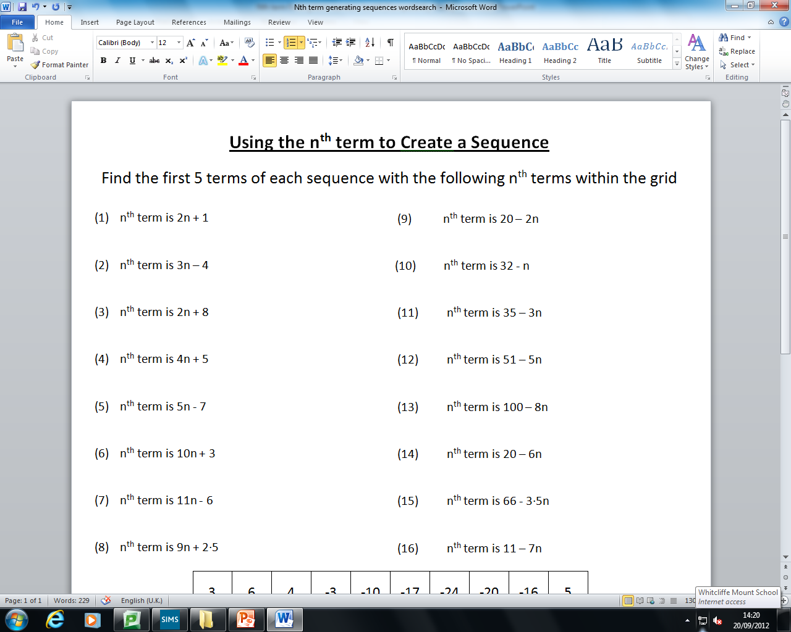
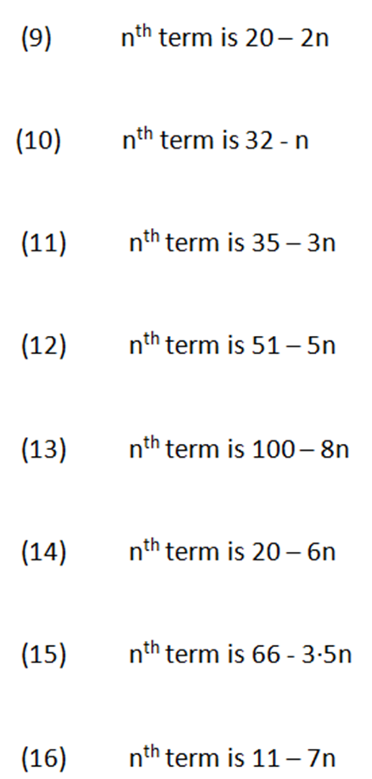
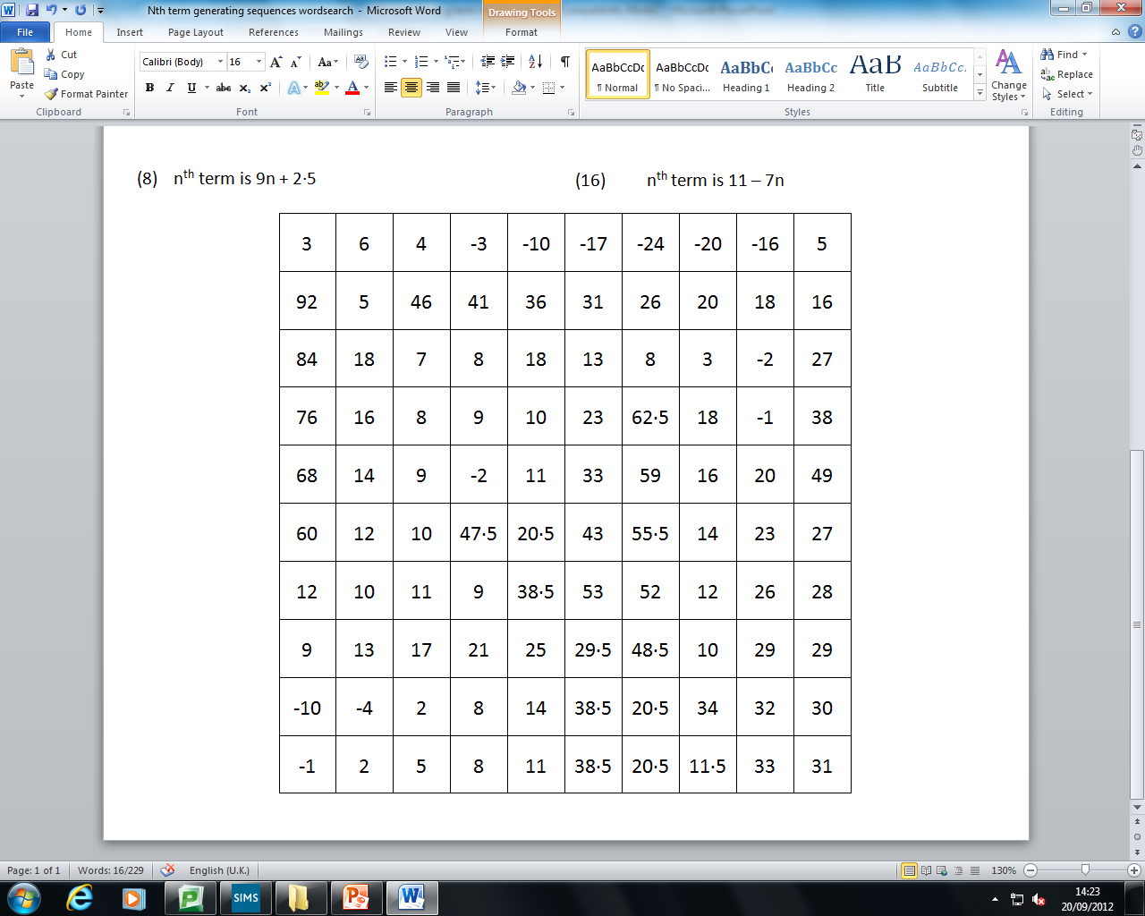
Nth Term
Find the first 5 terms of each sequence with the following n^{th} terms within the grid
Notes:
1

Slide 2
Nth Term
TASK (Level 6)
Find the first 5 terms of each sequence with the following n^{th} terms within the grid
3, 5, 7, 9, 11
18, 16, 14, 12, 10
-1, 2, 5, 8, 11
31, 30, 29, 28, 27
10, 12, 14, 16, 18
32, 29, 26, 23, 20
9, 13, 17, 21, 25
46, 41, 36, 31, 26
-2, 3, 8, 13, 18
92, 84, 76, 68, 60
13, 23, 33, 43, 53
14, 8, 2, -4, -10
5, 16, 27, 38, 49
62.5, 59, 55.5, 52, 48.5
11.5, 20.5, 29.5, 38.5, 47.5
4, -3, -10, -17, -24
Notes:
2

